Slide 1

Computer Organization
Chapter 10 Primary Memory

Slide 2
Primary Memory
10.1 Introduction
10.2 Random Access Memory (RAM)
10.3 ROM and Flash Memory
10.4 High Speed Memory
10.5 Cache
10.6 Virtual Memory

Slide 3
10.1 Introduction
Development of Memory
Performance Character
Classification
Multi-layer Memory System

Slide 4
10.1 Introduction
Development
  The first computer uses Tube trigger；
    Mercury delay line（汞延迟线）
    Magnetic tape（磁带）
    Magnetic Drum（磁鼓）
    Magnetic core（磁芯（1951年始））
    Semiconductor（半导体）
    Disk - CD – Nanomemory（磁盘—光盘—纳米存储）

Slide 5
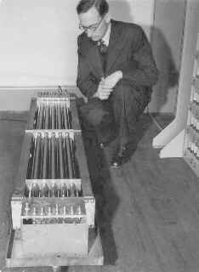
汞延迟线

Slide 6
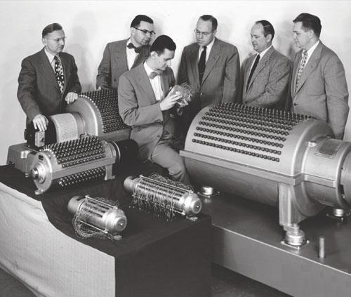
磁鼓

Slide 7
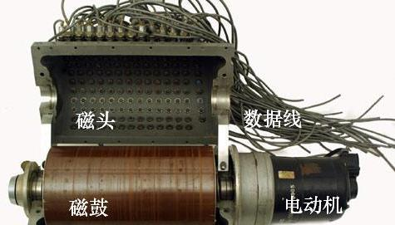

Slide 8
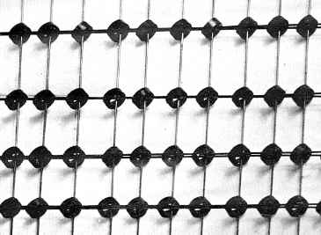
磁芯

Slide 9
10.1 Introduction
Summary of History of Primary Memory:
area | device | Access cycle | Storage Capacity
1 | Magnetic drum 磁鼓等 | 12µs | 2K字节
2 | Magnetic core 磁芯 | 2.18µs | 32K字节
3 | Magnetic core | 750mµs | 1M字节
3.5 | IC，LSI | 320mµs | 8M字节
4 | VLSI | 312mµs | 128M字节

Slide 10
10.1 Introduction
Development
  capacity
Bit(b) Byte(B) KiloByte(KB) MegaByte(MB)
GigaByte(GB) TeraByte (TB)
PetaByte(PB) ExaByte (EB) ZetaByte(ZB)
YottaByte(YB) NonaByte(NB) DoggaByte (DB)
单位名称 | 常规十进制表示 | 存储器容量表示
K（Kilo） | 1K＝10³＝1000 | 1K＝2¹⁰＝1024
M（Mega） | 1M＝10⁶＝10³K | 1M＝2²⁰＝2¹⁰K＝1 048 576
G（Giga） | 1G＝10⁹＝10⁶M | 1G＝2³⁰＝2¹⁰M＝1 073 741 824
T（Tera） | 1T＝10¹²＝10⁹G | 1T＝2⁴⁰＝2¹⁰G＝1 099 511 627 776

Slide 11
10.1 Introduction
Development
    ① from Main – Auxiliary to multi-layered
    ② single to Multi-body cross（parallel）。
    ③ Virtual memory

Slide 12
10.1 Introduction
Main Characters for Evaluation Primary Memory
  3 Key characters：
    Capacity, speed and price
    Larger, faster and cheaper
  price
    Price per bit， P=C/S
    C—price of memory，S—capacity（bits）
    Larger capacity, faster speed-→ higher price

Slide 13
10.1 Introduction
Speed
  (1) Memory Access Time（存取时间TA）：consider r/w operation once. The time from sending R signal to data is get.
  (2) Memory Circle Time（存储周期TM）：consider interval between two continuous r/w operation.
  (3) Bm (频带宽度)：data that access in unit time.
  Bm=W/TM（位/秒）
  W —— data width of R/W，generally equals to word length of memory
  TM——Memory Circle Time
TM is the most important among the above 3 characters，which comprehensively reflect working efficiency of memory.

Slide 14
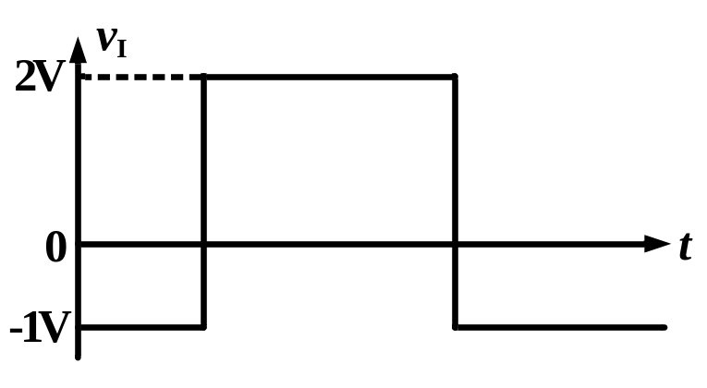
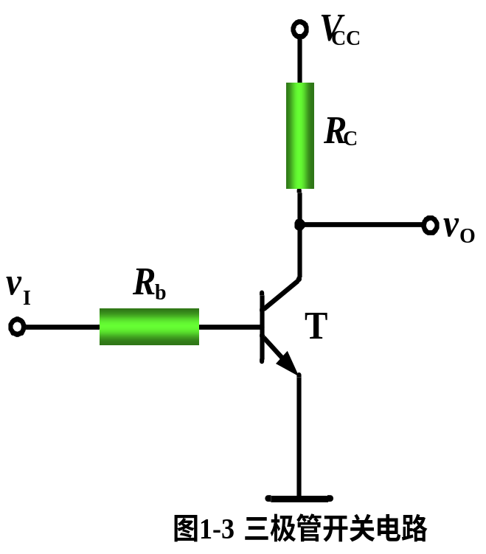
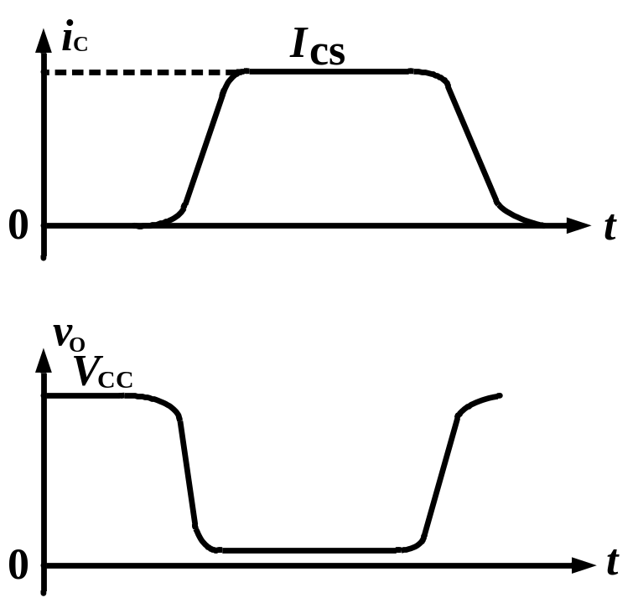
三极管的开关时间
存储时间t_{s}
上升时间t_{r}
延迟时间t_{d}
下降时间t_{f}
0.9I_{CS}
0.1I_{CS}
开启时间t_{on}=t_{d}+t_{r}
关闭时间t_{off}=t_{s}+t_{f}

Slide 15
10.1 Introduction
Classification
  By Storage Media：Magnetic/semiconductors
  By access mode：Random / sequential (tape)
  By r/w function：ROM，RAM
    RAM： static ram /dynamic ram
    ROM：MROM/PROM/EPROM/EEPROM
  By effection: Primary / secondary / cache / control memory

Slide 16
10.1 Introduction
Multi-layered Memory
  Speed of memory falls behind the need of CPU.
  The capacity of memory falls behind the need of software.
  In order to solve demands of bigger capacity, higher speed, lower cost, multi-layered memory structure is adopted, that is cache-primary memory-external memory.

Slide 17
10.1 Introduction
Multi-layered Memory
Increase in capacity
CPU
GPR(通用寄存器)
Increase in speed
host
Cache (SRAM)
Main Memory(DRAM，SRAM)
External device
Secondary Storage联机外部存储器(磁盘等)
External memory脱机外部存储器(磁带、光盘存储器等）

Slide 18
Primary Memory
10.1 Introduction
10.2 Random Access Memory (RAM)
10.3 ROM and Flash Memory
10.4 High Speed Memory
10.5 Cache
10.6 Virtual Memory

Slide 19
10.2 RAM
Classify into static ram and dynamic ram, depending on whether it can save information in a long time.

Slide 20
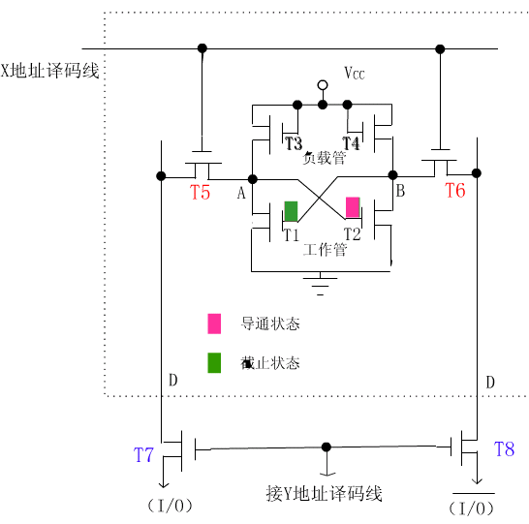
10.2 RAM
SRAM——storage element(存储元)
Storage element can store a binary 0 or 1.
The circuit of SRAM is based on triggers.
composed of two MOS inverter cross-coupled, can store a binary bit information and with stable status.
Write principle
Read principle
Hold stable status

Slide 21
10.2 RAM
SRAM——basic composition
  SRAM is composed of storage, r/w device, address decoder and control circuit.
address
decoder
& driver
cell
array
I/O and R/W
Control circuit
Data bus
Address bus
R/W signal

Slide 22
10.2 RAM
Storage
storage
CPU
Storage
element
Cell address
00…00
00…01
.
.
.
.
.
XX…XX
MAR
••• ••• •••
Storage
cell
┇
┇
┇
size
Relationship between main component

Slide 23
10.2 RAM
Address Decoder and Driver System(地址译码驱动系统)
  CPU gives the address of a specific storage cell.
  Decode the address to access control information
A0 A0 A1 A1
Word strobe line
字线
A0
A1
·
w00
&
·
w01
&
w10
&
w11
&

Slide 24
10.2 RAM
Address Decode and Driver System:
1-dimensional and 2-dimensional decode mode
  1-D(一维地址译码方案): every storage cell of storage array is driven by one word strobe line(也叫字线）, which is also called single decode.
  example: 1K × 4bit RAM。
  The number of word strobe lines needed：1024

Slide 25
10.2 RAM
2-Dimensional (二维地址译码方案):
  address lines derivate from CPU is separated to two parts, R(Row) and C(Column) address decoders. These two parts select a storage cell if they both are valid.
  Example: 1K × 4位 RAM
  10 address lines of 1K×4 RAM. 6 of them (A0～A5) uses as Row-address Strobe(RAS), the other 4 (A6～A9) are used as Column-address Strobe(CAS).
  There are totally 2⁶+2⁴=64+16=80 word strobe lines.

Slide 26
10.2 RAM
SRAM——case of chip
Intel 2114
  External pins: 18
  Power, data bus, address bus, control bus
D₁ D₂ D₃ D₄
V_{cc}A₇ A₈ A₉ I/O₁I/O₂I/O₃I/O₄WE
18
17
16
15
14
13
12
11
10
2114(1K*4)
1
2
3
4
5
6
7
8
9
A₆ A₅ A₄ A₃ A₀ A₁ A₂ CS 地

Slide 27
10.2 RAM
Interconnection of RAM Chip for Larger Capacity
  A number of RAM chips can be interconnected to form a main memory module of large size.
  The number of chips used is determined by the word length and address length of the memory module.
    Bit expansion
    Word expansion
    Hybrid method：composition of the above two methods.

Slide 28
10.2 RAM
Bit Expansion
  Example：use 8K X 1 RAM to make up 8K X 4 RAM
address bus
A12
~
A0
A12~A0
A12~A0
A12~A0
A12~A0
CPU
8K× 1
8K× 1
8K× 1
8K× 1
1
2
3
4
D0
D0
D0
D0
D3
~
D0
D0
D1
D2
Data bus
D3

Slide 29
10.2 RAM
Word Expansion
  use 16K×8 ram to make up 64K×8 ram
  solution: address assignment and chip selection logic
addr | 片外A₁₅ A₁₄ | 片内A₁₃ A ₁₂ A₁₁ A₁₀ A ₉ A₈ A₇ A₆ A₅ A₄ A₃ A₂ A₁ A₀
1 | 00 00 | 00 0000 0000 0000 11 1111 1111 1111
2 | 01 01 | 00 0000 0000 0000 11 1111 1111 1111
3 | 10 10 | 00 0000 0000 0000 11 1111 1111 1111
4 | 11 11 | 00 0000 0000 0000 11 1111 1111 1111

Slide 30
10.2 RAM
Word Expansion
  use 16K×8 ram to make up 64K×8 ram
A15
2：4
decoder
A14
CE
16K×8
WE
CE
16K×8
WE
CE
16K×8
WE
CE
16K×8
WE
A0
A0
A0
A0
A0
…
…
…
…
CPU
…
A13
A13
A13
A13
A13
D7—D0
D7—D0
D7—D0
D7—D0
WE
D7—D0

Slide 31
10.2 RAM
Interconnection of RAM Chip for Larger Capacity
  Hybrid method(位字扩展法）
  there are 2114(1K×4 RAM) storage chips，and we want to form 8K X 16 memory module. How many 2114 should be selected？ Draw the expansion, connection diagram.
  Calculate how many 2114：(8K×16)/(1K×4)=32 chips
    Bit expansion：expand 1K×4 to 1K×16，using 16/4=4 chips；
    Word expansion：1K —8K，using 8 1K×16 chips.
    So we totally need 32 2114 chips.

Slide 32
10.2 RAM
Hybrid Method(位字扩展法）
  using 2114(1K×4 RAM) chips form 8K X 16 memory module.
    Bit expansion：1K×4 to 1K×16，we need 16/4=4；
A9
…
A0
(1#) 2114
A0……A9
R/W CS
D3 D2 D1 D0
(2#) 2114
A0……A9
R/W CS
D3 D2 D1 D0
(3#) 2114
A0……A9
R/W CS
D3 D2 D1 D0
(4#) 2114
A0……A9
R/W CS
D3 D2 D1 D0
D15
D0
R/W
CS

Slide 33
10.2 RAM
Hybrid Method(位字扩展法）
  using 2114(1K×4 RAM) chips form 8K X 16 memory module.
    Word expansion ：1K—8K
A12
3/8
DEC
7
A11
A10
0
A9
…
(1#) 2114×4
1K×16bit
A0 …… A9
R/W CS
D15 …… D0
(2#) 2114×4
1K×16bit
A0 …… A9
R/W CS
D15 …… D0
(8#) 2114×4
1K×16bit
A0 …… A9
R/W CS
D15 …… D0
A0
……
D0~15
R/W

Slide 34
10.2 RAM
Connection between Storage and CPU
  Storage of chips logic diagram shows:
    all chips selected, including CPU, storage chips, decoder……
    address and data lines of each chip
    chip selection logic（CS）
    r/w control and memory request line MREQ
  notes:
    number and direction of address bus and data bus
    Try to use decoder to form chip selection logic

Slide 35
10.2 RAM
DRAM
  SRAM store information in a long time, do not need refresh, work in a stable status.
  disadvantage：high power consumption, low integration
  DRAM overcomes these disadvantages.
  DRAM is a progress to semiconductor memory technology.

Slide 36
10.2 RAM
DRAM——Circuit Component
  A MOS Transistor T and a Capacitance C
  C is with small capacitance, fast charge, and can keep charge in a long time
Word strobe line(字线W)
T
C
CD
D（位线）

Slide 37
10.2 RAM
DRAM——Working Principle
(1) hold(保持)：if there exist charge in C, then it is “1”，else it is “0”
  Word line is low at the stay status. turn off the ‘T’, and C path is cut off, then the charge can not be released.
  there is resistor to leak charge.
  So, reason for refresh.
Word strobe line(字线W)
T
C
R
CD
D（位线）

Slide 38
10.2 RAM
(2) write：word strobe line is high , turn on switch T.
  Write “1”：put high in D；write “0”：put low in D
(3) read： word strobe line is high, turn on switch T
  Stored “1”：charge pass T, and make D high.
  Stored “0”：D is low.
  So, DRAM is read in a damage way.
  The data needs restore when it is read.
  Otherwise, its information will be lost.
Word strobe line字线W
T
C
R
CD
D（位线）

Slide 39
10.2 RAM
DRAM——Refresh
  1、refresh：leakage causes charge attenuated. So the data must be restored regularly, and this is called refresh.
  2、refresh cycle：the whole DRAM must be refreshed in a fixed time interval. Otherwise, data will be wrong. Interval between the end of previous refresh and the end of the next refresh is called refreshed cycle.
  3、refresh mode：Centralized, distributed, asynchronous

Slide 40
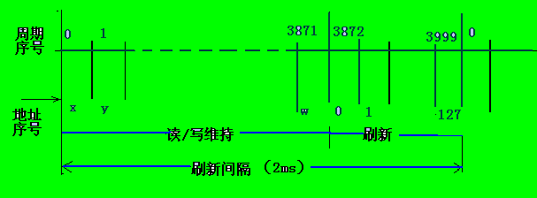
10.2 RAM
DRAM——Refresh
  Centralized：the first part is used for r/w. When there needs refresh, we stop r/w, and refresh the whole DRAM row by row. It is fit for high speed memory.

Slide 41
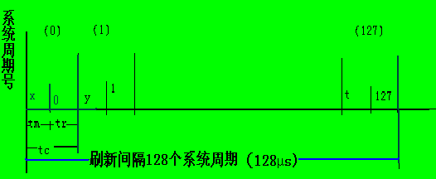
10.2 RAM
DRAM——Refresh
  distributed：divide a memory cycle TC into two parts. The first part TM is used for r/w or maintenance. The second part TR is used for refresh. In this way, after 128 system cycle, the whole memory will be refreshed.

Slide 42
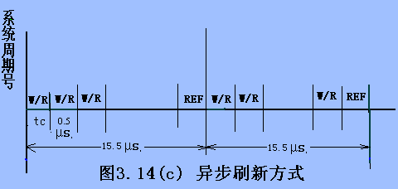
10.2 RAM
DRAM——Refresh
  Asynchronous: composition of the above two modes.

Slide 43
Primary Memory
10.1 Introduction
10.2 Random Access Memory (RAM)
10.3 ROM and Flash Memory
10.4 High Speed Memory
10.5 Cache
10.6 Virtual Memory

Slide 44
10.3 Rom and Flash Memory
ROM
用户编程
ROM
工厂编程
Mask PROM
PROM
一次编程
OTP PROM
EPROM
多次编程
UV EPROM
E²PROM
Standard E²PROM
Flash E²PROM

Slide 45
10.3 Rom and Flash Memory
Vcc
ROM
Address
decoder
1001
A₀
0100
0101
A1
1010
r/w
r/w
r/w
r/w
D0
D1
D2
D3

Slide 46
10.3 Rom and Flash Memory
Connection between ROM, RAM and CPU
  According to specific address assignment, we select appropriate storage chips and other chips and gate circuits. Linking address lines, data lines and control lines,
  So, CPU and memory are connected to form a whole memory system.

Slide 47
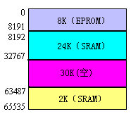
10.3 Rom and Flash Memory
i.e：address lines of CPU: 16(A15—A0，A0 is LSB), dual data line 8 (D7—D0), control lines MREQ(允许访存， 低电平有效) and R/W(high for a read signal, low for a write signal).
Address space assignment of memory：
  0—8191 are used for system program,
  which is composed of ROM chip;
  8192—32767 are user program area；
  The last 2k space are used for
  system working area.
  Number of address is decimal,
  addressed by byte.

Slide 48
10.3 Rom and Flash Memory
Now we have chips as follows:
  EPROM：8K×8位(only has CS);
  SRAM：16K×1, 2K×8, 4K×8, 8K×8.
Please select chips to design main memory system. Drawing the diagram of main memory system. Drawing chip selection logic .
Solution: we select
    EPROM：8K×8, 1 chip
    SRAM： 8K×8, 3 chips
    2K×8, 1 chip

Slide 49
10.3 Rom and Flash Memory
Solution: we select
    EPROM：8K×8, 1 chip
    SRAM： 8K×8, 3 chips
    2K×8, 1 chip
D0
…
D7
D7 … D0
SRAM
8K×8
A0……A12
CPU
D7 … D0
SRAM
8K×8
A0……A12
D7 … D0
EPROM
8K×8
A0……A12
D7 … D0
SRAM
8K×8
A0……A12
D7 … D0
SRAM
2K×8
A0……A10
CS
R/W
CS
R/W
CS
CS
R/W
CS
R/W
R/W

Slide 50
List Address Space Assignment in Binary Form
A15 A14 A13 A12 A11 A10 A9 A8 A7 A6 A5 A4 A3 A2 A1 A0
0 0 0 0 0 0 0 0 0 0 0 0 0 0 0 0 ┇ ┇
0 0 0 1 1 1 1 1 1 1 1 1 1 1 1 1
0 0 1 0 0 0 0 0 0 0 0 0 0 0 0 0 ┇ ┇
0 0 1 1 1 1 1 1 1 1 1 1 1 1 1 1
0 1 0 0 0 0 0 0 0 0 0 0 0 0 0 0 ┇ ┇
0 1 0 1 1 1 1 1 1 1 1 1 1 1 1 1
0 1 1 0 0 0 0 0 0 0 0 0 0 0 0 0 ┇ ┇
0 1 1 1 1 1 1 1 1 1 1 1 1 1 1 1
1 1 1 1 1 0 0 0 0 0 0 0 0 0 0 0 ┇ ┇
1 1 1 1 1 1 1 1 1 1 1 1 1 1 1 1
Y0
8K
Y1
8K
Y2
8K
Y3
8K
Y7
A12*A11
2K

Slide 51
10.3 Rom and Flash Memory
D0
…
D7
D7 … D0
SRAM
8K×8
A0……A12
D7 … D0
SRAM
8K×8
A0……A12
D7 … D0
EPROM
8K×8
A0……A12
D7 … D0
SRAM
8K×8
A0……A12
D7 … D0
SRAM
2K×8
A0……A10
CPU
CS
R/W
CS
R/W
CS
CS
R/W
CS
R/W
R/W
A0
…
A10
A11
A12
A13
A14
Y0 Y1 Y2 Y3 … Y7
A15
74LS138
C B A G1
MREQ

Slide 52
Chapter 10 Primary Memory
10.1 Introduction
10.2 Random Access Memory (RAM)
10.3 ROM and Flash Memory
10.4 High Speed Memory
10.5 Cache
10.6 Virtual Memory

Slide 53
10.4 High Speed Memory
Methods to Improve the Speed of Memory
—reduce the differences in speed between the CPU and memory
  ①set more general registers in inner CPU
  ②research on new technology of DRAM chip；
  ③consideration on architecture of memory
  ④multi-layered memory system

Slide 54
10.4 High Speed Memory
Dual-port memory（port means r/w port）
Address Reg
decoder
Memory
array
Address Reg
decoder
Addr
······
······
······
······
Addr
MAR
MAR
DATA
Data Reg
Data Reg
DATA
WE
r/w circuit
r/w circuit
WE
arbitration logic
端口：指读写口
Diagram of dual-port memory

Slide 55
10.4 High Speed Memory
Associative Memory
——Content Access Memory(相联存储器)
  nature of CAM
    CAM is accessed by content.
  application
    IR, Cache and virtual memory
    Used for address transformation of cache and high speed search management in virtual memory.

Slide 56
10.4 High Speed Memory
Multimodule Interleaved-Memory
  Concept: Linear address(Continuous address)
  address mode of linear address in two ways:
  ①in sequence
    Storage cell is arranged one by one, i.e, mode 2 is followed by mode 1….；
    Cross in high bit（address of mode is in high part）
  ②in interleaved

Slide 57
Suppose main memory has 4 modes, 32 storage cells
4 3 2 1 0
MEM addr：
Module-Num
Address in mode
分体号
decoder
Need a set of AR, DR and R/W
M₀
M₁
M₂
M₃
多
模
块
的
顺
序
编
址
方
式
00 000
01 000
10 000
11 000
00 001
01 001
10 001
11 001
Goal:
Expand capacity of memory.
00 010
01 010
10 010
11 010
00 011
01 011
10 011
11 011
00 100
01 100
10 100
11 100
Realize:
High part of address represents module-number, and low part is addressed in module.
00 101
01 101
10 101
11 101
00 110
01 110
10 110
11 110
00 111
01 111
10 111
11 111
16
16
16
16
MDR（16 bits）
DB（16bits）

Slide 58
10.4 High Speed Memory
② in interleaved
  Address is arranged module by module;
  interleaved in low part of address（模块地址在低位）；
  Most commonly used in parallel main computer system.

Slide 59
address：
4 3 2 1 0
Address in mode
Module-Num
decoder
MAR₀
MAR₁
MAR₂
MAR₃
Search module
000 00
000 01
000 10
000 11
多
模
块
的
交
叉
编
址
方
式
001 00
001 01
001 10
001 11
010 00
010 01
010 10
010 11
011 00
011 01
011 10
011 11
Each memory module has a MDR decoder, driver, r/w devices .
100 00
100 01
100 10
100 11
101 00
101 01
101 10
101 11
110 00
110 01
110 10
110 11
111 00
111 01
111 10
111 11
16bits
16 bits
16 bits
16 bits
MDR₀
MDR₁
MDR₂
MDR₃
Data Bus（16位）

Slide 60
10.4 High Speed Memory
Multimodule Interleaved-Memory
  i.e ：there is 4-module interleaved memory.
  Start r/w circle one by one with 1/4Tm interval.
W₀ M₀
W₃ M₃
W₂ M₂
W₁ M₁
W₀ M₀
T
τ
time
  Like pipeline work style

Slide 61
10.4 High Speed Memory
Ex: We use 16M*8bit memory chip to form a 64M*16bit main memory module. Required that the capacity of storage be expand, the access time be reduced.
Questions:
  (1)How many 16M*8bit memory chips should be used?
  (2)Give the address length of each memory chip and address length of main memory module.
  (3)Drawing the diagram of using chips to construct main memory.
  (4)For an address (2345678)₁₆, give its body number and address inside the body.

Slide 62
10.4 High Speed Memory
(1)How many 16M*8bit memory chips should be used?
A： 8
(2)Give the address length of each memory chip and address length of main memory module.
A: The address length of 16M×8bit memory chip is 24. The address length of 64M×16bit main memory is 26.
(4)For an address (1234567)₁₆, give its body number and address inside the body.
A: right shift of 1234567 by 2 bits is 48D159. So its inner address is (48D159)₁₆. Its low 2 bits (11)₂，so its module number is 3.

Slide 63
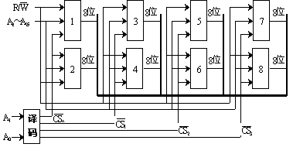
10.4 High Speed Memory
(3)Drawing the diagram of using chips to construct main memory.
A2～A25
A1
A0

Slide 64
Chapter 10 Primary Memory
10.1 Introduction
10.2 Random Access Memory (RAM)
10.3 ROM and Flash Memory
10.4 High Speed Memory
10.5 Cache
10.6 Virtual Memory

Slide 65
10.5 Cache
Cache-principle (程序访问的局部性原则)
——based on program locality of memory references
Analysis shows that computers have a tendency to repeatedly access the same locality of memory.
That is, when a program executes on a computer, most of the memory references in a given period of time refer to only a few locations.
A cache memory is a high speed RAM that stores the most commonly accessed data and instructions, so that the processor will most frequently access the faster cache memory rather than go to the slower main memory.

Slide 66
10.5 Cache
Cache Organization
block
Address bus
Main Memory
replacement
MAR
miss
CPU
CAR
multiword
M-Cache
Address
mapping
hit
Cache
Cell array
Data bus
Single word

Slide 67
10.5 Cache
Basic Concept
1、 “block”（block frame ）
  Unit for exchange data between cache and memory.
  Divide cache and memory into blocks.
  Blocks are equal size.
  Commonly the size of block is a unit that can be accessed in a r/w cycle.（i.e：32B，64B，128B）

Slide 68
10.5 Cache
Basic Concept
2、 Cache Hit Ratio h=Nc / (Nc+Nm)
the number of times referenced data are in cache
total number of memory references
  When CPU access memory, the probability of data in cache.
1-h ——miss ratio（loss ratio）
h =

Slide 69
10.5 Cache
Basic Concept
3、Effective Access Time Te=h×T_{hit}+(1-h)T_{miss}
  T_{hit}--time spent accessing memory during the event of a cache hit i. e. , cache access time (Tc)
  T_{miss-}--time spent accessing memory during the event of a cache miss i.e., the time spent for transferring a main memory block to the cache (Tm)
  Te---average access time (Ta)

Slide 70
10.5 Cache
Basic Concept
4、Access Efficiency of Cache e
e＝Tc/ Ta＝ Tc /[ h× Tc ＋(1-h) Tm]
＝1/[h+(1-h)(Tm / Tc)]
Let r= Tm / Tc represent times that cache comparing to memory,
then：
e＝1 / [h+( 1-h )r] = 1 / [r+(1-r)h]

Slide 71
10.5 Cache
Ex: CPU performs a program; it accesses cache 1900 and accesses main memory 100. Known that Tc = 1ns, Tm = 6ns. Solving that the efficiency (e) and Ta of the cache/memory system.
answer：
h = Nc/(Nc+Nm) = 1900/(1900+100) = 0.95
r = tm/tc = 6ns/1ns = 6
e = 1/[r+(1-r)h] = 1/[6+(1-6)X0.95] = 80.0%
ta= tc/e = 1ns/0.80 = 1.25ns
ta= h*tc+(1-h)tm = 0.95X1+0.05X6=1.25ns
e = tc/ta = 1/1.25 = 80.0%

Slide 72
10.5 Cache
Mapping and transform between cache and memory
  memory—cache mapping：put data of memory in cache by some scheme. And block table(块表) can be build.
    block table——judge whether Cache is hit. Realized by hardware, and its size equals to blocks of cache.
  memory—cache transform：according to block table, transform content in MAR into CAR (address of cache)

Slide 73
10.5 Cache
Mapping Functions between Cache and Memory
  （1）fully-associative cache (全相联映射）
  （2）direct-mapped cache （直接映射）
  （3）set associative cache （组相联映射）

Slide 74
10.5 Cache
（1） fully-associative cache
  Each block in memory can be mapped into every block of cache.
memory
Cache
Block 0
Block 0
block 1
Block 1
…
…
…
Block 15
Block 2047

Slide 75
10.5 Cache
Memory address formation:
  ex: memory size is 1MB. Cache size is 8KB. Block size is 512B. Then memory has 2048 blocks, and cache has 16 blocks.
Memory Block number | Inner address
Block
0
0000 0000 000 0 0000 0000
Inner storage cell
(0-511)
…
0000 0000 000 1 1111 1111
Block
1
0000 0000 001 0 0000 0000
Inner storage cell
(0-511)
…
0000 0000 001 1 1111 1111
……
1111 1111 111 0 0000 0000
Block
2047
Inner storage cell
(0-511)
…
1111 1111 111 1 1111 1111

Slide 76
10.5 Cache
Cache address formation:
Cache Block number | Inner address
Block0
0 000 0 0000 0000
Inner storage cell
(0-511)
…
0 000 1 1111 1111
Block 1
0 001 0 0000 0000
Inner storage cell
(0-511)
…
0 001 1 1111 1111
……
1 111 0 0000 0000
Block15
Inner storage cell
(0-511)
…
1 111 1 1111 1111

Slide 77
10.5 Cache
（1） fully-associative cache
Memory Block number
Inner addr W
MAR
Cache b num
Inner addr w
CAR
miss
Access memory
compare
hit
Cache table
B
b
•••
•••
Memory Block Number
Cache block Num
fully-associative mapping

Slide 78
10.5 Cache
（1） fully-associative cache
Advantage
  A fully associative cache has great flexibility in mapping a memory block to any cache block.
  Block miss ratio is lowest, unless the cache is full of data.
Disadvantage
  The implementation of fully associative cache is too costly. Because all tags in the cache must be searched in order to determine whether a given block is in the cache.
  This type of search is called an associative search, using associative memory, consisting of complex circuitry.

Slide 79
10.5 Cache
（2）direct-mapped cache
  Mem address:
  Cache address:
Main memory
Block 000
Block 001
Block 010
Block 011
Block 100
Block 101
Block 110
Block 111
cache
0区
Block 00
Block 01
Block 10
Block 11
1区
区内块号
Cache块号
区号
块内地址
Cache块号
块内地址

Slide 80
10.5 Cache
（2）direct-mapped cache
区号E
块号B
块内地址W
MAR
块号b
块内地址w
CAR
②
①
送CPU
不等
相等
选择信号
③
比较
③
1/w
访问主存
…
多路选择器（w中选1）
②
…
…
cache
E
D0
D1
…
Dn-1
…
区号E
数据D0
数据D1
…
数据Dn-1

Slide 81
10.5 Cache
（2）direct-mapped cache
Advantage
  It is straightforward and easy to implement.
Disadvantage
  It is not very flexible.

Slide 82
10.5 Cache
（3）set associative cache
  Mem address：区号E+组号G+组内块号B+块内地址W
  Cache address： 组号g+组内块号b+块内地址w
Main memory
000块
第
0
组
cache
001块
第
0
区
第
0
组
00块
010块
第
1
组
01块
011块
10块
100块
第
0
组
第
1
组
101块
第
1
区
11块
110块
第
1
组
111块

Slide 83
10.5 Cache
（3）set associative cache
区号E
组号G
组内块号B
块内地址W
MAR
组号g
组内块号b
块内地址w
CAR
不命中
访问Cache
比较
访问主存
命中
块表：每组一个，行数等于组内分块时块的个数。每行记录了主存某块送入cache时原在主存的区号、组内块号及放入cache中的组内块号。
块表
┇
┇
●
●
┇
┇
区号E 主存组内块号B
Cache组内块号b

Slide 84
10.5 Cache
cache address transform
Ex：Memory capacity is 1MB. Cache capacity is 8KB. Block capacity is 512B. Direct-mapped function is adopted:
  (1) Gives address formation of main memory and cache;
  (2) Draw the diagram of direct mapping and transform;
  (3) Which position does cell 0022AH of memory exist in cache ?

Slide 85
10.5 Cache
Ex：Memory capacity is 1MB. Cache capacity is 8KB. Block capacity is 512B. Direct-mapped function is adopted:
  Gives address formation of main memory and cache;
Answer：
  Memory address formation：
  Cache address formation：
区号(7位)
区内块号(4位)
块内地址(9位)
区内块号(4位)
块内地址(9位)

Slide 86
10.5 Cache
Main memory address
  (2) Draw the diagram
  of direct mapping
  and transform;
区号G
区内块号b
块内地址
7位
4位
9位
MAR
不命中,访问主存
Cache地址
比较
4位
9位
CAR
命中,
则根据CAR的内容访问Cache
0
1
…
…
区号
b
…
15

Slide 87
10.5 Cache
Ex：Memory capacity is 1MB. Cache capacity is 8KB. Block capacity is 512B. Direct-mapped function is adopted:
  (3) Which position does cell 0022AH of memory exist in cache ?
answer：
  0022AH=(0000 0000 0010 0010 1010)₂
区
(0区)
区内块号
(1块)
块内地址
(42字)

Slide 88
10.5 Cache
cache address transform
ex：A cache using set-associative mapping. Memory and cache is addressed by byte. Word length is 64-bit. Memory capacity is 64M. Cache capacity is 256KB. Cache group has 8 blocks, and each block contains 8 words. Give mapping and transform between memory and cache.
  (1) Give address formation of memory and cache.
  (2) Give the number of associated table address.
  (3) Give content format of associated table.
  (4) Give bits of compare circuit.
  (5) Which fields of cache address can be directly gained from the address of memory ? Which fields must be get from associated table ?

Slide 89
10.5 Cache
ex：A cache using set-associative mapping. Memory and cache is addressed by byte. Word length is 64-bit. Memory capacity is 64M. Cache capacity is 256KB. Cache group has 8 blocks, and each block contains 8 words. Give mapping and transform between memory and cache.
  (1) Give address formation of memory and cache.
Memory address formation:
(8)
(9)
(3)
块内地址W
(6)
区号E
区内组号G
组内块号B
64M/256K＝2⁸
8块/组＝2³
256K/(8块/组*8字/块*8字节/字)＝2⁹
8字/块*8字节/字＝2⁶
Cache address formation:
区内组号g
(9)
组内块号b
(3)
块内地址w
(6)

Slide 90
10.5 Cache
ex：A cache using set-associative mapping. Memory and cache is addressed by byte. Word length is 64-bit. Memory capacity is 64M. Cache capacity is 256KB. Cache group has 8 blocks, and each block contains 8 words. Give mapping and transform between memory and cache.
  (2) Give the number of associated table address.
Memory address formation:
区号
(8位)
区内组号
(9位)
组内块号
(3位)
块内地址
(6位)
∴相联目录表的地址个数是2⁹＝512

Slide 91
10.5 Cache
ex：A cache using set-associative mapping. Memory and cache is addressed by byte. Word length is 64-bit. Memory capacity is 64M. Cache capacity is 256KB. Cache group has 8 blocks, and each block contains 8 words. Give mapping and transform between memory and cache.
  (3) Give content format of associated table.
Memory address formation:
区内组号G
组内块号B
块内地址W
区号E
(8)
(9)
(3)
(6)
Cache address formation:
区内组号g
(9)
组内块号b
(3)
块内地址w
(6)
相联目录表每个地址格式：共8组，每组3个字段
(8位)
(3位)共11位
(3)
(1)
……
(8位)
(3位)共11位
(3)
(1)
E； B
b
e
E； B
b
e

Slide 92
10.5 Cache
ex：A cache using set-associative mapping. Memory and cache is addressed by byte. Word length is 64-bit. Memory capacity is 64M. Cache capacity is 256KB. Cache group has 8 blocks, and each block contains 8 words. Give mapping and transform between memory and cache.
  (4) Give bits of compare circuit.
  每个比较电路的位数是11位。
  (5) Which fields of cache address can be directly gained from the address of memory ? Which fields must be get from associated table ?
  Cache地址组号g字段和块内地址w可从主存地址直接得到，组内块号b字段必须从相联目录表得到。

Slide 93
10.5 Cache
Cache Replacement Algorithms
  replacement：The processor perform a memory reference, if the desired content is not in the cache, the processor accesses the main memory and usually writes the content into the cache at the same time. If cache is full, then a block should be discarded, and the new block will be in the full position. This is called block replacement.
  Replacement algorithms(policies)：
  ——Commonly used（implemented by hardware）：
    RAND
    FIFO----First In First Out
    LRU----Least Recently Used

Slide 94
10.5 Cache
Cache replacement
I.E ：there are 8 blocks in memory(0-7). There are 4 blocks in Cache(0-3). Set-associate mapping is adopted, and there are 2 blocks in a group. LRU is used as replacement algorithm.
memory block flow : 1、2、4、1、3、7、0、1、2、5、4、6、4、7、2.
Let cache is empty initially. Please give detail usage of Cache.

Slide 95
10.5 Cache
I.E ：there are 8 blocks in memory(0-7). There are 4 blocks in Cache(0-3). Set-associate mapping is adopted, and there are 2 blocks in a group. LRU is used as replacement algorithm.
Access time: 1 2 3 4 5 6 7 8 9 10 11 12 13 14 15
Access flow : 1 2 4 1 3 7 0 1 2 5 4 6 4 7 2
01
2
3
4
5
6
7
1
1
1
1
1
4
1
1
1
1
1
1
1
4
0
块
分
配
情
况
1
4
4
4
4
1
4
4
4
4
0
0
0
0
5
5
5
5
5
4
5
2
2
2
2
2
7
2
7
7
7
7
7
6
7
6
6
2
6
3
3
3
3
2
3
2
2
2
2
2
3
7
7
miss
hit
Hit ratio: 3/15=0.2

Slide 96
10.5 Cache
Cache write policies
  The content of Cache is the copy of memory. When hit, if CPU write cache, then content of cache is changed. How to make content of cache and memory as the same ?
  Commonly used：
  1、whole write, write through：Write cache, while write memory at the same time.
  advantage: Synchronous.
  disadvantage: reduce efficiency of cache.

Slide 97
10.5 Cache
2、Write Back：set a label to cache when there exists write operation to cache. Write content to memory when the block is replaced out.
  advantage: reduce access to memory, high efficiency.
  disadvantage: there may exist dis-consistency of data in cache and memory.

Slide 98
Chapter 10 Primary Memory
10.1 Introduction
10.2 Random Access Memory (RAM)
10.3 ROM and Flash Memory
10.4 High Speed Memory
10.5 Cache
10.6 Virtual Memory

Slide 99
10.6 Virtual Memory
basic concept
Virtual memory
  In the previous section, we saw how caches provided fast access to recently used portions of a program’s code and data. Similarly, the main memory can act as a “cache” for the secondary storage, usually implemented with magnetic disks.
  This technique is called virtual memory. It is constructed by hardware and OS.

Slide 100
10.6 Virtual Memory
Comparison between Cache and Virtual Memory
  Same points：
  (1) program is divided into data blocks；
  (2) data blocks are transferred from slower storage to faster storage automatically；
  (3) need some replacement algorithm；
  (4) Loading a new block based on a mapped function;

Slide 101
10.6 Virtual Memory
Different points：
  (1) The goal of cache is designed for increase speed, while virtual is designed for increase storage capacity;
  (2) Data exchange between cache and memory is set as the same size. While data exchange between memory and secondary memory is set not uniform；
  (3) the speed CPU access cache is faster then memory for 5~10 times. While the speed access to memory is faster then to secondary memory for 100~1000 times；

Slide 102
10.6 Virtual Memory
  (4) in memory—cache architecture，CPU can access them directly. CPU could not access secondary memory directly.
  (5) cache-memory mapping and transform is realized by hardware, and is Transparent to programmer. While primary memory-secondary memory is managed by OS.

Slide 103
10.6 Virtual Memory
real address(physical address)
  An address in main memory.
Virtual address (logical address)
  An address that corresponds to a location in virtual space and is translated by address mapping to a physical address when memory is accessed.
Address Translation
  Also called address mapping.
  The process by which a virtual address is mapped to an address used to access memory.

Slide 104
10.6 Virtual Memory
page
  In virtual memory, blocks of memory(called pages) are mapped from one set of addresses(called virtual addresses) to another set (called physical addresses)
  Basic unit for data exchange between primary memory and secondary memory
  Divide primary memory and secondary memory into page with same size.
  Page capacity is usually 512 bytes, 1K、4K
  Address of memory is start from page 0

Slide 105
10.6 Virtual Memory
Page Table：
  Memory management software set page table for each program according its usage of memory, which is transparent to programmer.
  Page table is in a fixed region of memory. Each program has a page table.
  Page table records page position relationship between virtual memory and logic memory.

Slide 106
10.6 Virtual Memory
替
换
控
制
位
Virtual addresses
Physical addresses
装
入
位
修
改
位
其
他
实页号
1页
0虚页
1
1
3页
1虚页
1
3
0页
2虚页
1
19
程
序
A
1页
2页
6页
3虚页
1
6
3页
页表区中程序A的页表
“替换控制位：与替换策略有关，如采用LRU，替换控制位就可以用作计数位，记录这页在主存时被CPU调用的历史，反映这页在主存的活跃程度。
19页
“修改记录位”记录虚页内容在主存中是否被修改过，如果被修改过，则这页在主存被新页覆盖时要把修改的内容写回到虚存去。
页表的长度等于该程序虚页数,每一虚页的状况占据页表中一个存储字,叫页表信息字。
装入位为1时，表示该虚页内容已从辅存调入主存，页面有效。
Page table
register
页表首地址

Slide 107
10.6 Virtual Memory
Replacement Policies
  1、Rand
  2、FIFO
  3、LRU
  4、OPT

Slide 108
10.6 Virtual Memory
Ex：a program consists of 5 pages. During program execution, the page address stream is as follows, P1、 P2、 P1、 P5、 P5、 P1、 P3、 P4、 P3、 P4. Suppose that during program execution , system allocates only three pages to the main memory of this program.
Question:
  (1) Give dispatch table of using replacement policies of FIFO, LRU, OPT.
  (2) Working out the page hit ratio using LRU.

Slide 109
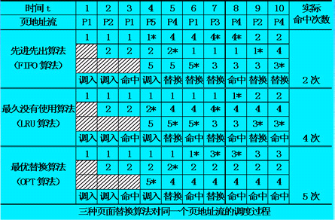
1
1
2
4
4
4
5
3
1
1
3
2
5
4
4
4

Slide 110
10.6 Virtual Memory
page virtual memory
  （2）
  Answer : Hp = 4/10 = 0.4

Slide 111
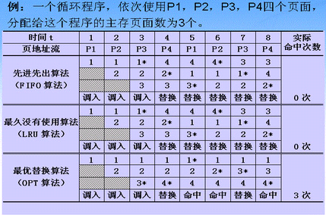

Slide 112
Summary
10.1 Introduction
  main character for evaluating memory
  multi-layered memory system
10.2 RAM
10.3 ROM and Flash
  DRAM refresh
  Connection between ROM, RAM and CPU
10.4 High Speed Memory
  multimode cross memory
10.5 Cache
  Hit rate, address transform, replacement algorithm
10.6 Virtual Memory
  Page management, replacement policies

